Slide 1


AI & ML for Process Analytical Technology using Python Day 1: Python fundamentals
João Coutinho
CInTech: Polo Tecnológico de Inovação, Translação e Industrialização de Medicamentos Injetáveis Complexos
Projeto nº 30 – Referência 7131, (Código do projeto: C644865576-00000005)

Slide 2
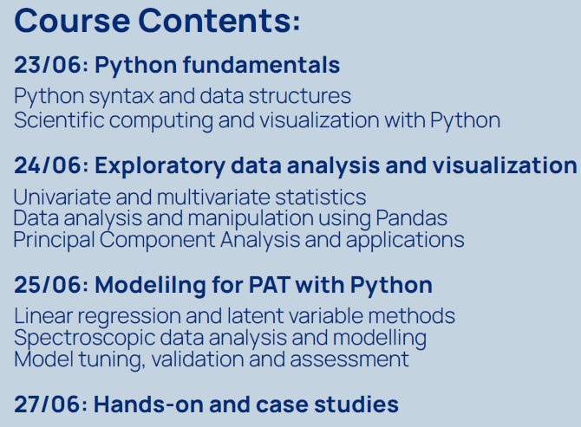
Course overview
Schedule:
Class 1: 9h30 - 11h
Class 2: 11h15 – 13h
Lunch: 13h – 14h
Class 3: 14h – 15h30
Class 4: 15h45 – 17h30
90 min classes
Active learning throughout

Slide 3
Day 1 overview
Class 1: Python introduction, installation
Class 2: Python fundamentals
Python syntax, basic operations and data structures
Logic, loops, functions
Class 3: Numpy
Array and matrix creation
Indexing and sorting arrays
Matrix operations
Class 4: Matplotlib
Line plots, scatter plots
Plot customization
3D plots

Slide 4
Part 1: Python intro and installation

Slide 5
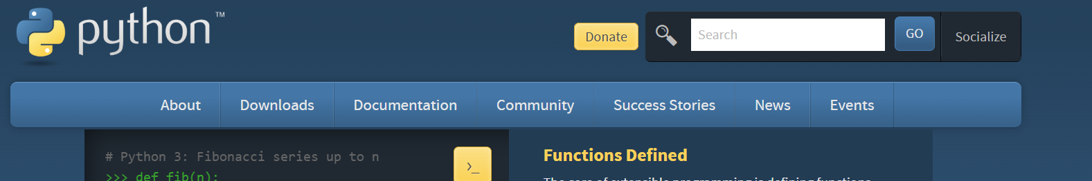
Python introduction
Python is a high-level object-oriented programming language
Python was released around the 1990’s but recently became very popular
Very large community – Python is currently the most popular programming langage in the world

Slide 6
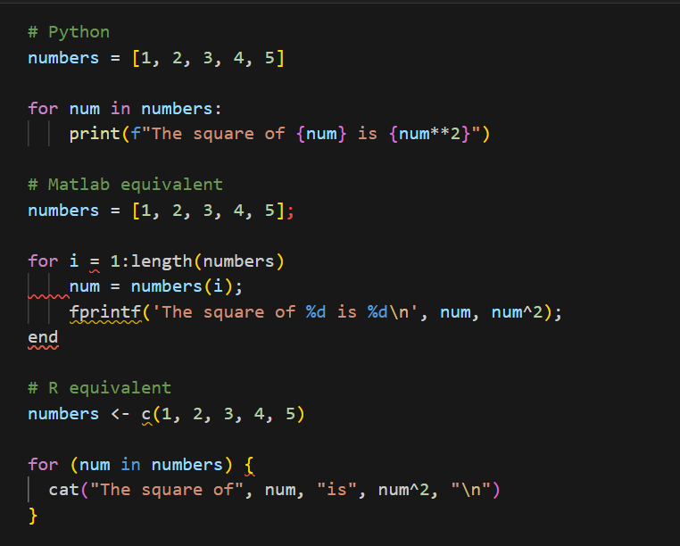
Why Python?
Python enables much clearer syntax and coding than other languages (R or Matlab)
Cleaner code = easier to read = easier to debug = easier to maintain
Direct iteration over elements
Identation clearly guides code viewing
No ‘end’ for loops: identation is enough
No ‘;’ required
Simpler f-strings insted of ‘fprintf’
No ‘<-’ or ‘{ }’ required

Slide 7
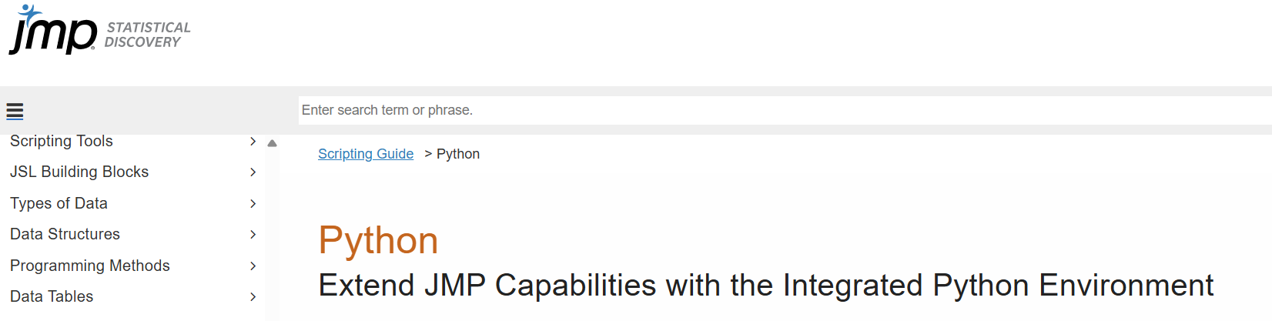
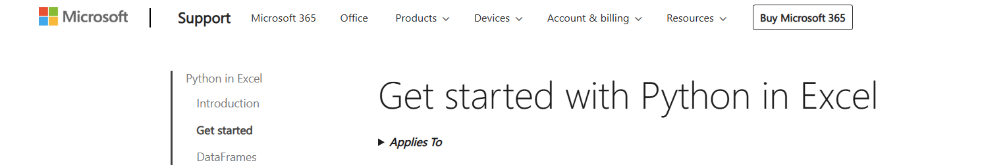
Why Python?
Free and open source – you can access every single line of code inside every package
Community-driven language: community is actively releasing and updating code
Integration with other industrially used tools such as JMP or Excel

Slide 8
Why Python?
Very flexible – there are Python packages for almost anything:
Web development
Interactive Apps
Image Analysis
Data analysis and manipulation
Data Science and Machine learning
Scientific computing
Deep learning and AI
All the state-of-the-art AI and ML is done in Python:
Tensorflow (Google)
Pytorch (Meta)
Pre-trained AI models (Hugging Face)
Large Language Models like ChatGPT are developed based on Python
The only field where Python is ‘lagging a bit behind’ is in Automation and Control (especially compared to Matlab) – although there are some Python packages for this

Slide 9
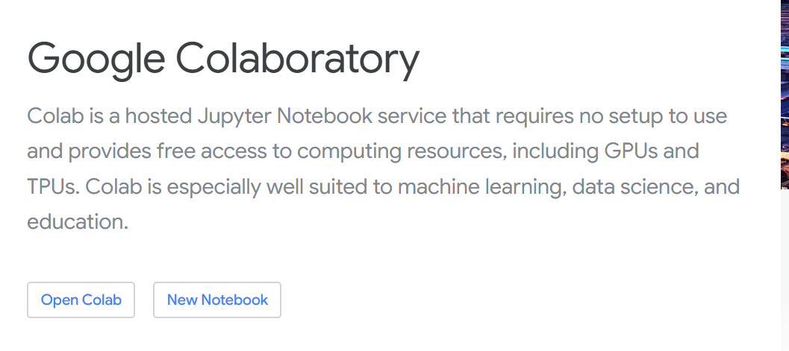
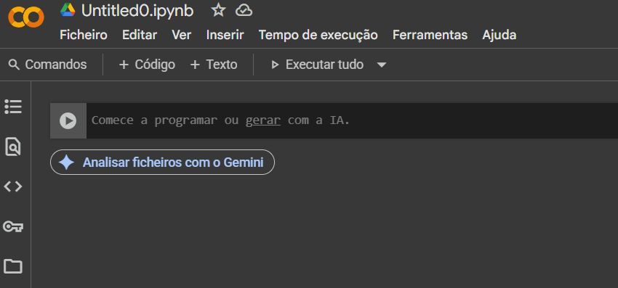
Google colab
Google Colaboratory enables to run Python code without installing Python software
It runs on the Google cloud and is useful for education purposes or to share code/results
It comes with all of the popular Python packages pre-installed
A Google account is required

Slide 10
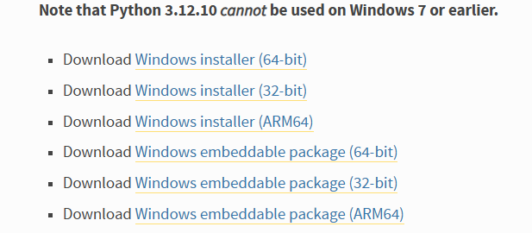
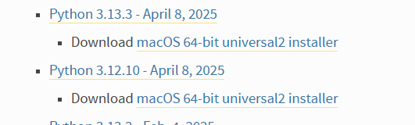
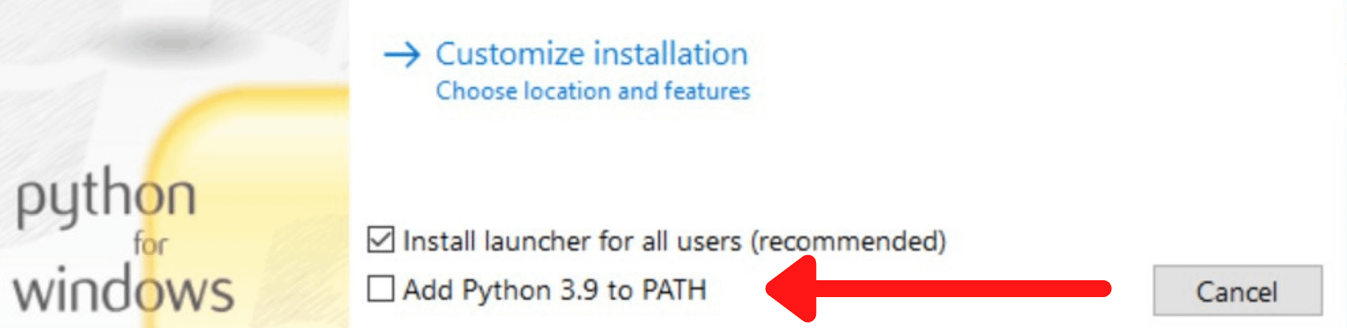
Python Installation
1. Install Python (version 3.12 is reccomended)
https://www.python.org/downloads/
If using Windows, it is reccommended to add Python to PATH

Slide 11
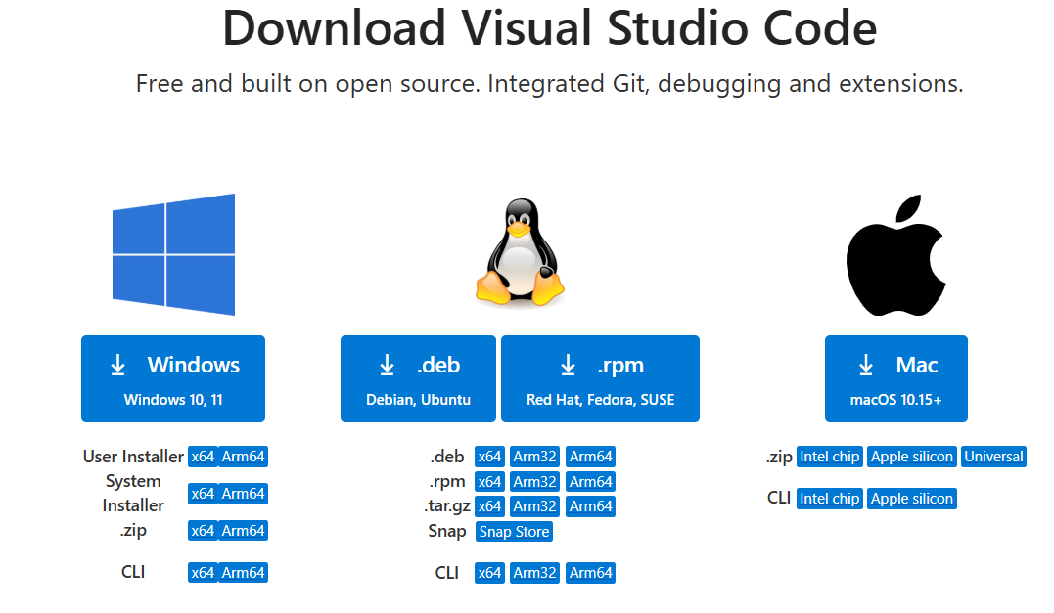
Python Installation
2. Install VS Code - recommeded IDE/code editor
https://code.visualstudio.com/download

Slide 12
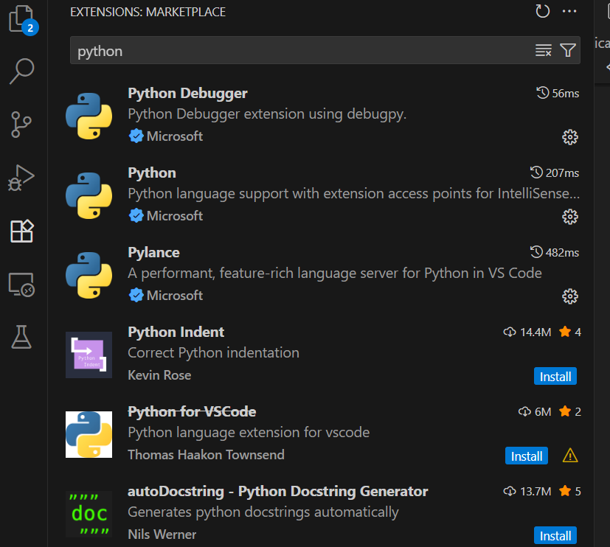
Python Installation
3. Install VS Code Python extension

Slide 13
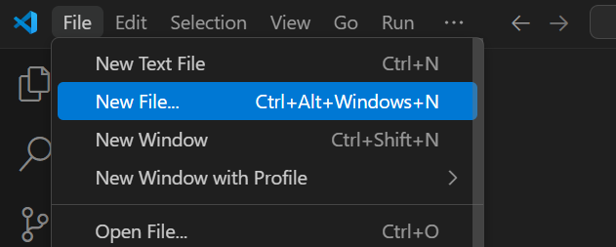
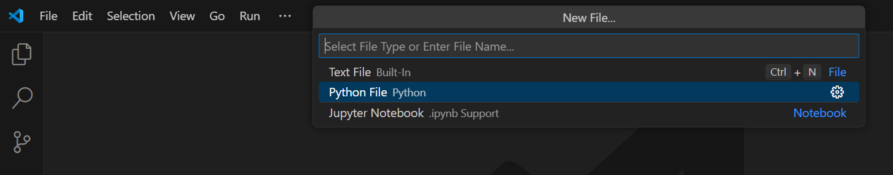
Python Installation
4. Test installation

Slide 14
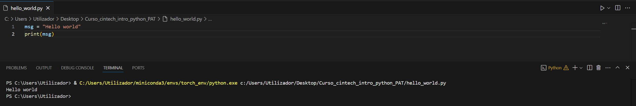
Python scripts vs interactive editors (Jupyter notebook)
Python scripts (.py files) output the result of the code to the terminal
Python scripts are useful for defining custom functions, but not for interactive analysis

Slide 15
Python package installation
Using Python we have to be actively involved with package installation and management
Packages used in this workshop:
Jupyter
Numpy
Matplotlib
Scipy
Pandas
Scikit-learn
Seaborn
Packages can be installed via:
command-line / terminal
directly in a Python script/ Jupyter notebook
This step can be skipped if using Google colab

Slide 16
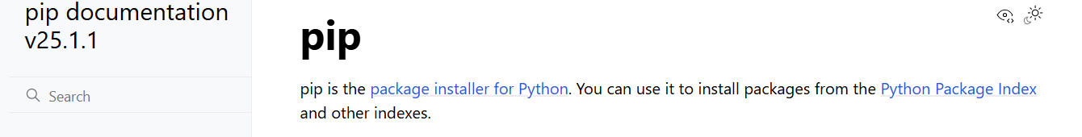
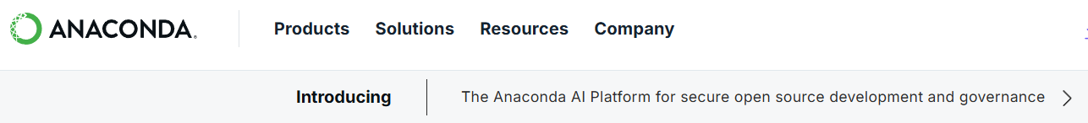
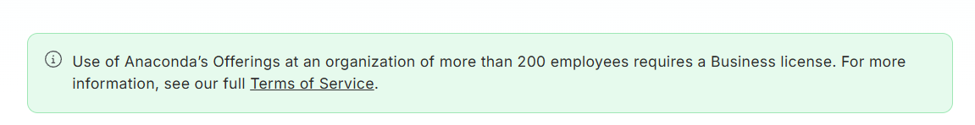
Python package installation
4. Install packages
We will use Pip (https://pypi.org/project/pip/) which is the native Python package instalar
Notes:
Anaconda is a popular package manager but requires paid license for company use

Slide 17
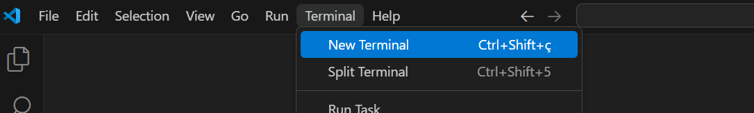
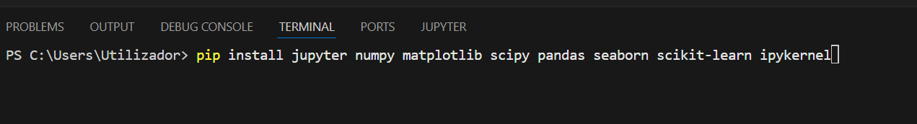
Python package installation
Open up the terminal in VS Code
Install the necessary packages

Slide 18
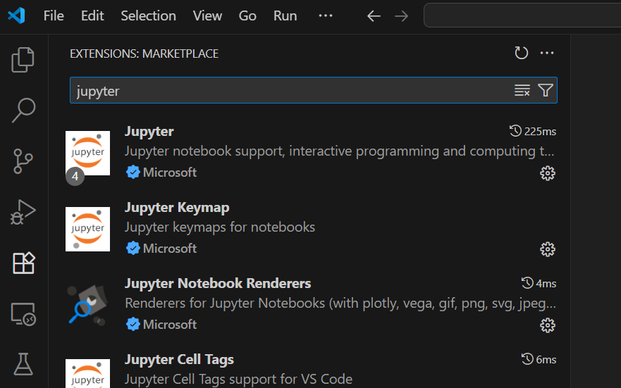
Jupyter Notebook
Install Jupyter notebook extension for VS Code (https://code.visualstudio.com/docs/datascience/jupyter-notebooks)

Slide 19
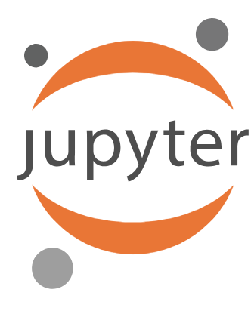
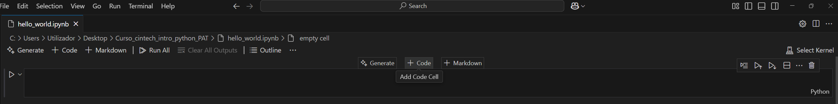
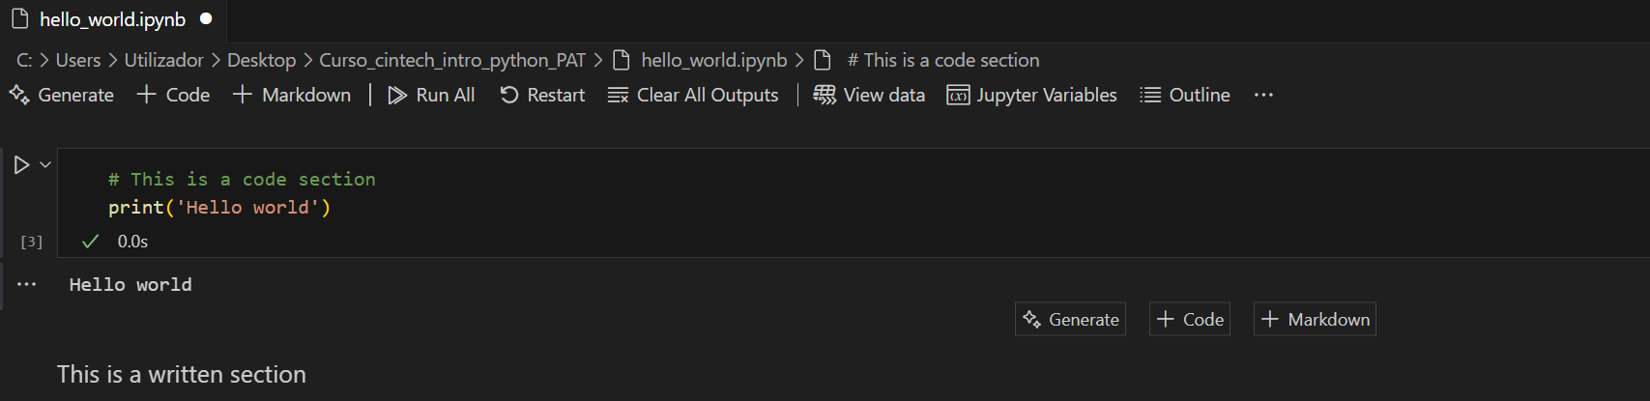
Python scripts vs interactive editors (Jupyter notebook)
Jupyter notebooks are very popular for interactive code development and data analysis
https://jupyter.org/
Notebooks allow for integration of code and written sections
Explain the code and results to other people or write personal memos

Slide 20
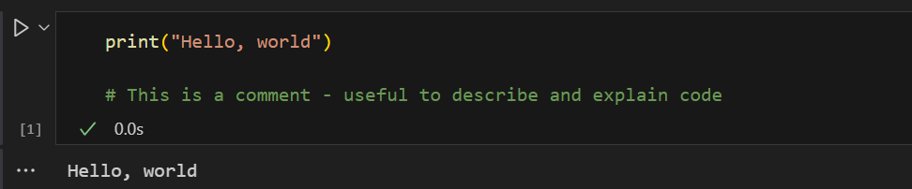
Jupyter notebook
Choose kernel (or Python environment)
Run code inside cell
Cell number after running code
Output of the code cell

Slide 21
Part 2: Python fundamentals

Slide 22
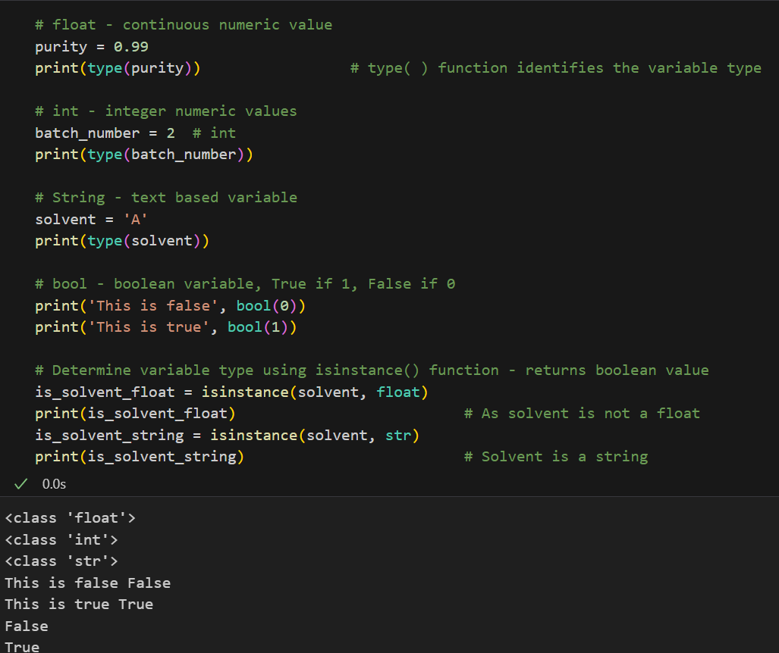
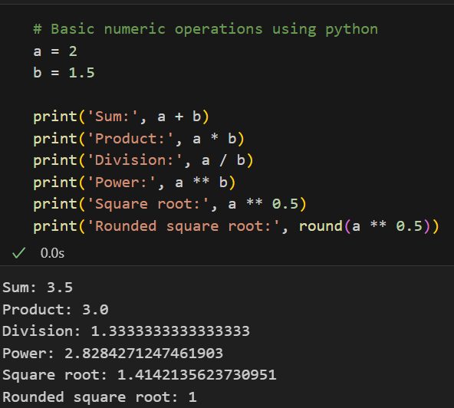
Python - Basic variable types and simple math operations

Slide 23
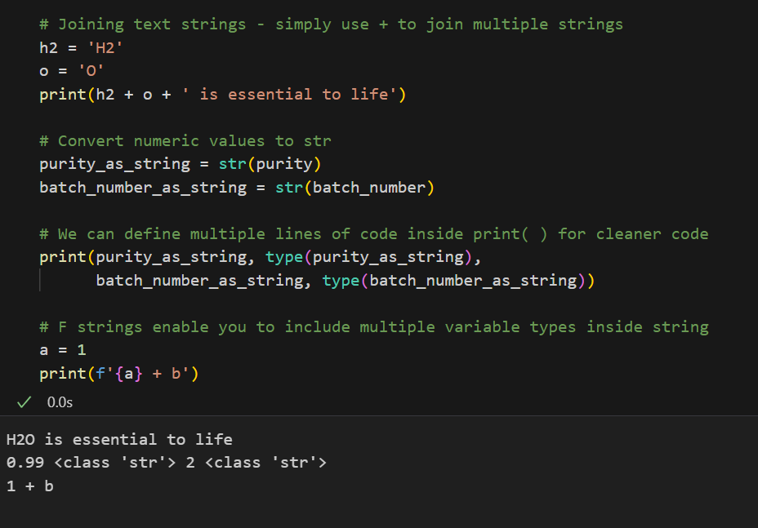
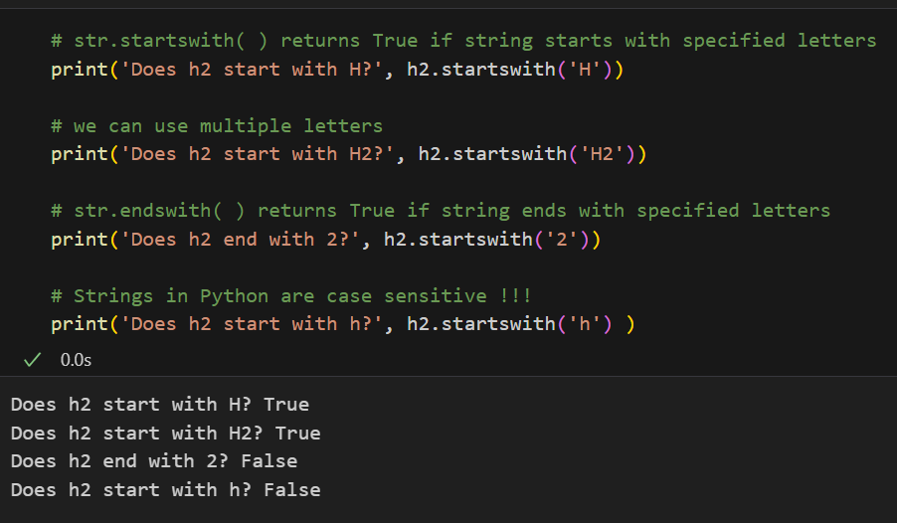
Python – string operations

Slide 24
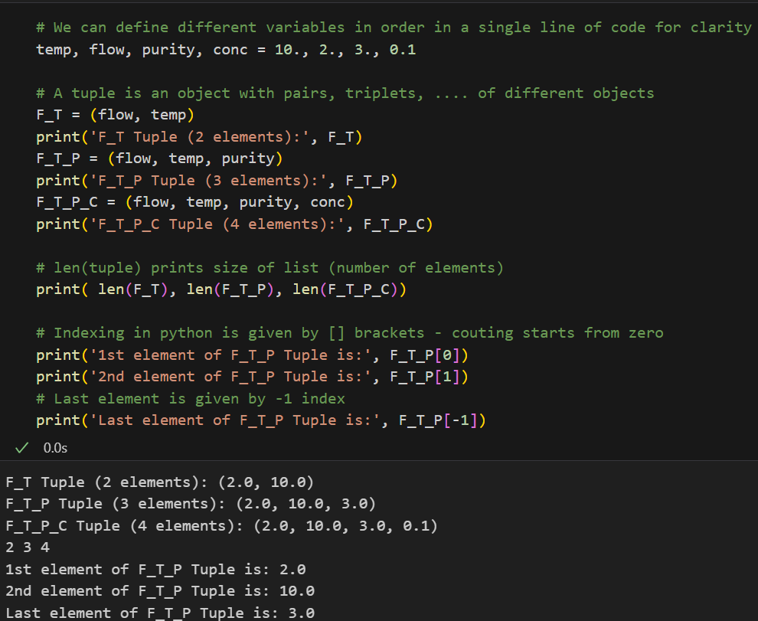
Python – tuples

Slide 25
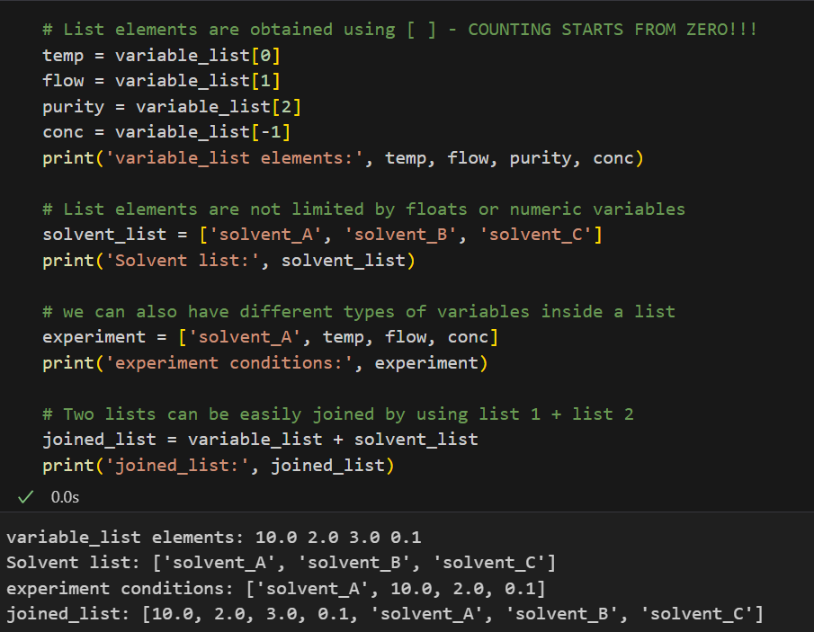
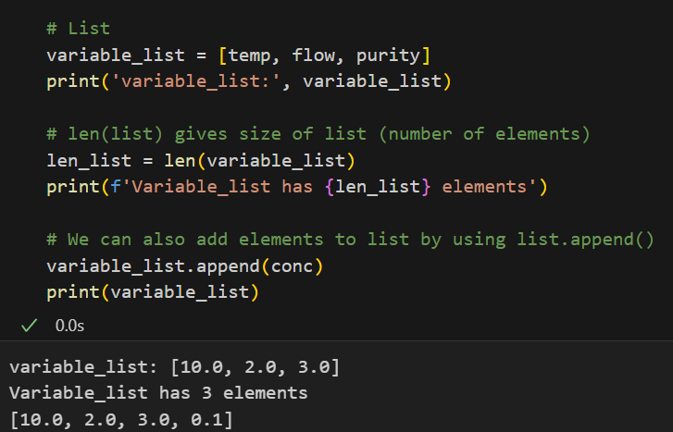
Python – lists

Slide 26
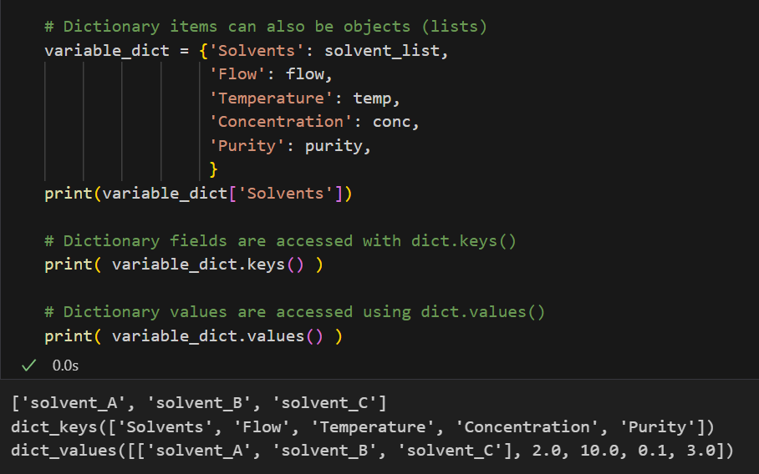
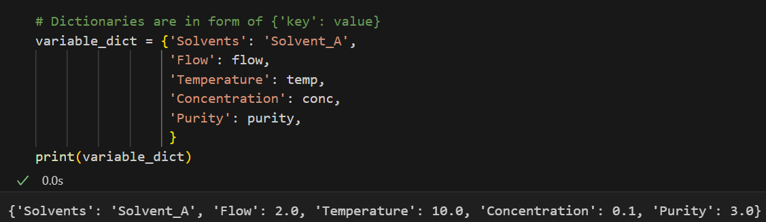
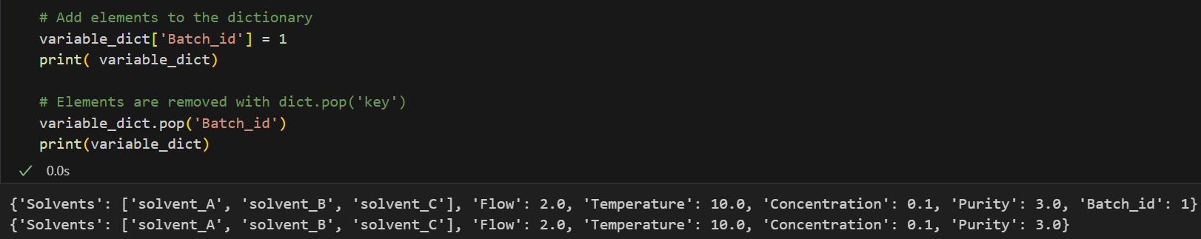
Python - dictionaries

Slide 27
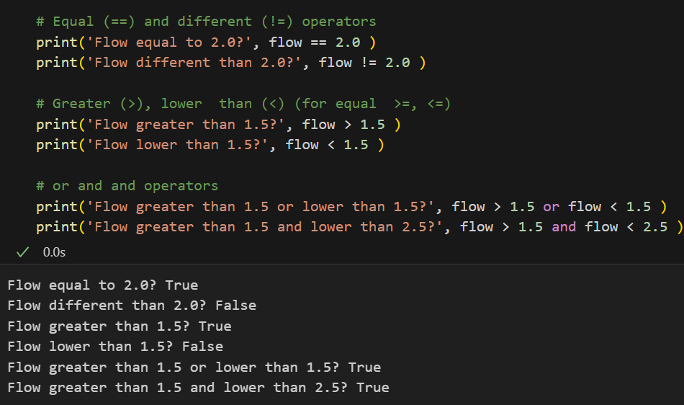
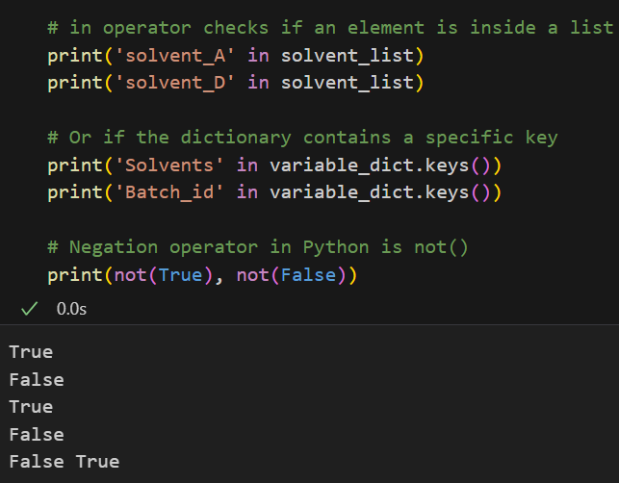
Python – logic and conditionals

Slide 28
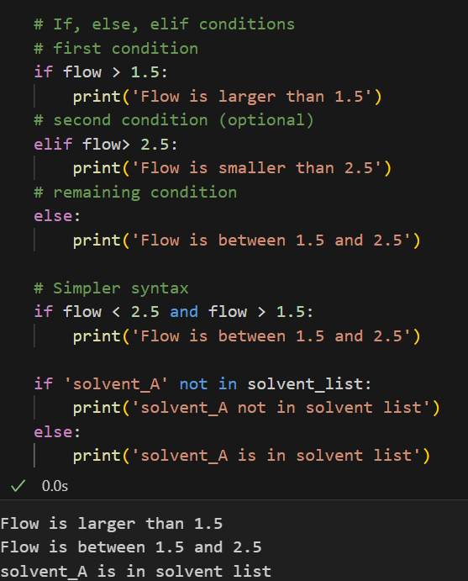
Python – if, else, elif

Slide 29
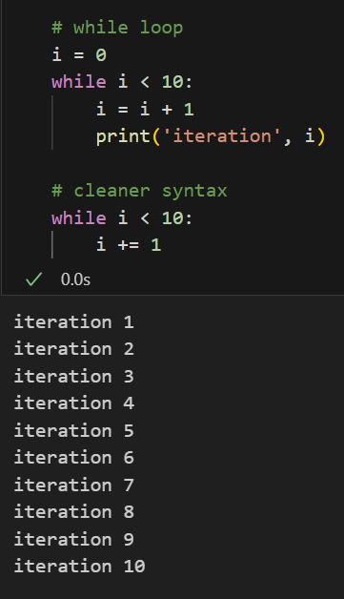
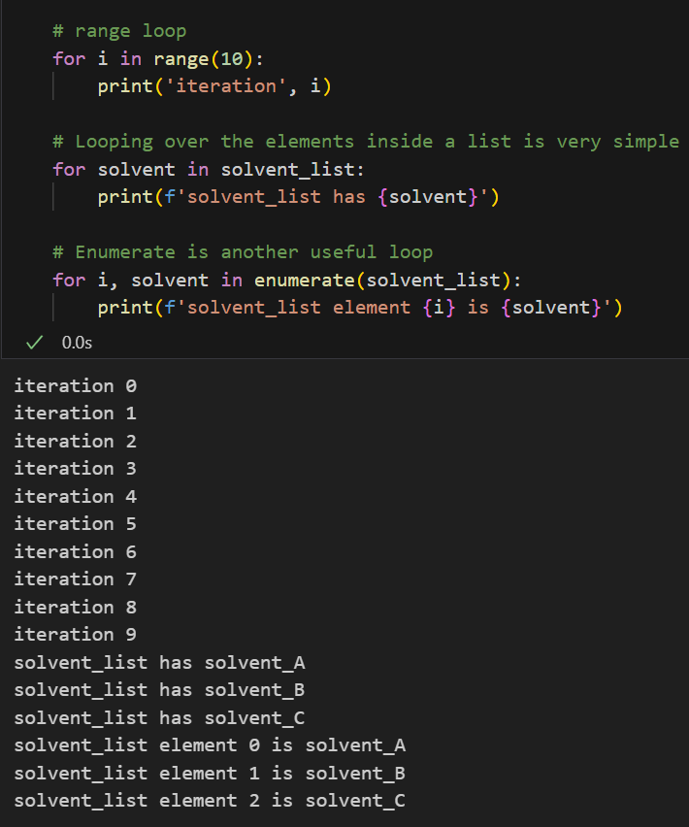
Python - loops

Slide 30
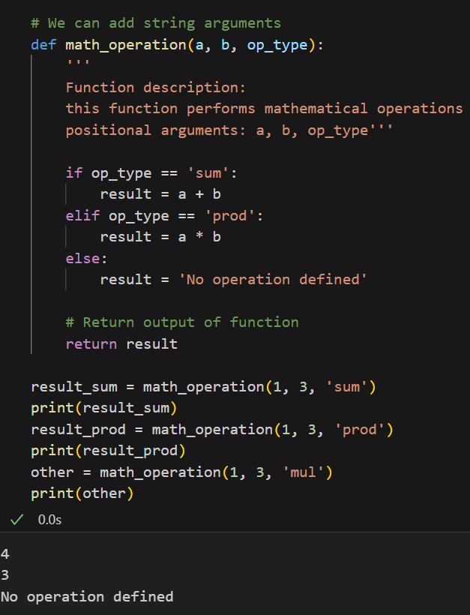
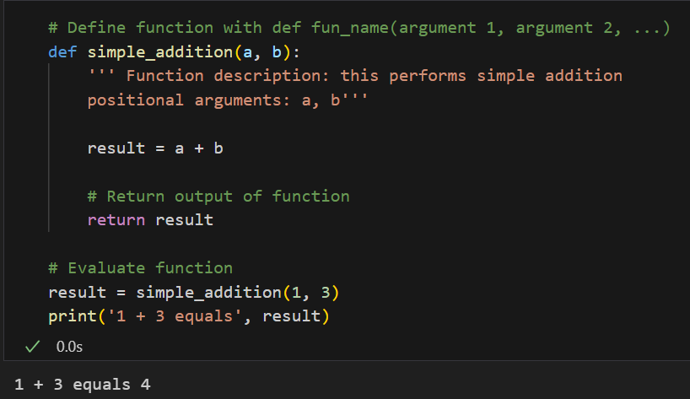
Python - functions

Slide 31
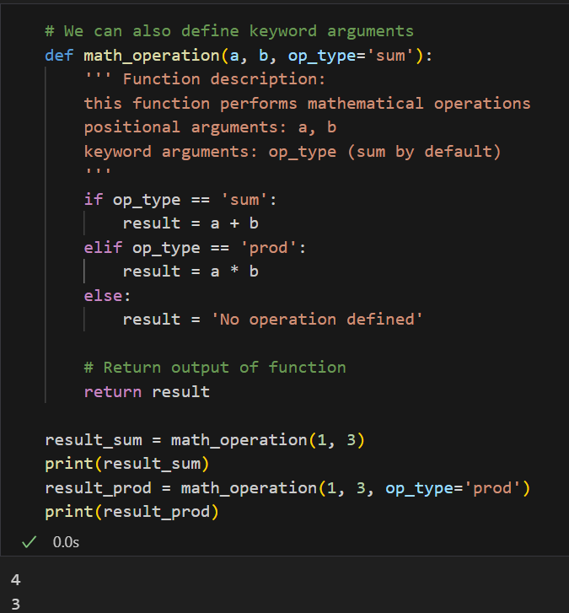
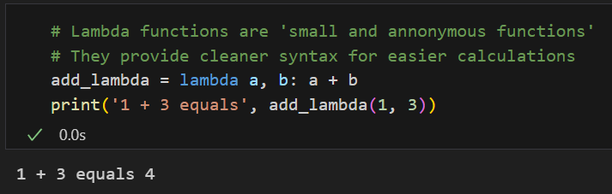
Python - functions

Slide 32
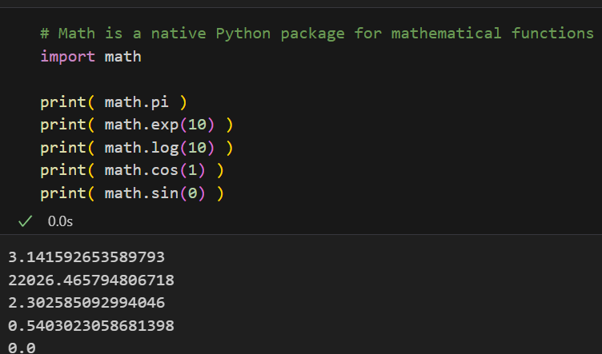
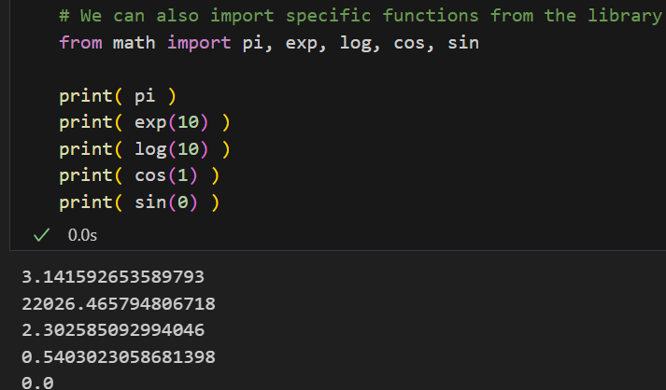
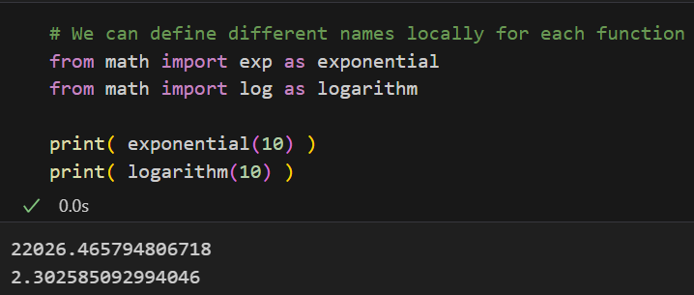
Python package import
Packages can be simply view as a collection of functions and objects defined inside specific Python files

Slide 33
Part 3: Numpy

Slide 34
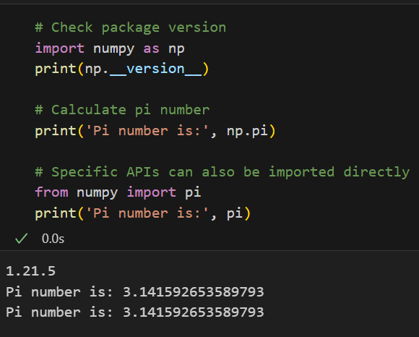
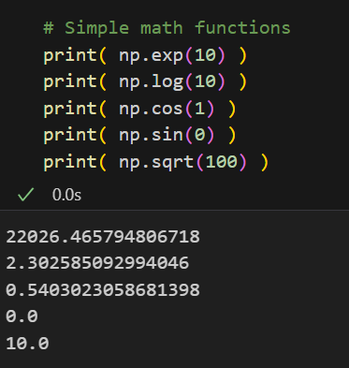
Numpy
Numpy is a package for scientific computing using Python
Many functions are wrapped around efficient C code – very fast calculations with Numpy

Slide 35
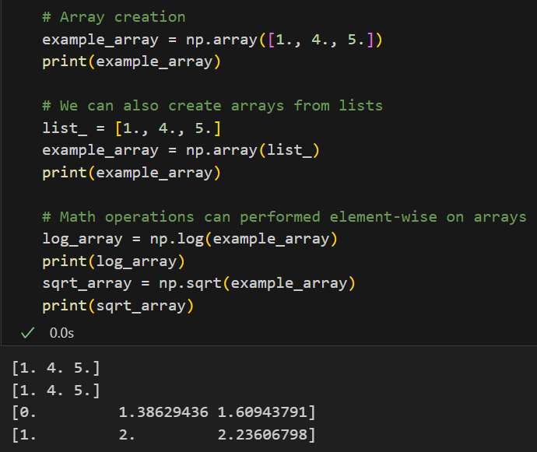
Numpy – array creation

Slide 36

Numpy – array creation

Slide 37


Numpy – matrix creation

Slide 38


Numpy – array and matrix manipulation

Slide 39

Numpy – indexing arrays

Slide 40


Numpy – sorting arrays

Slide 41

Numpy – logic and conditionals

Slide 42

Numpy – linear algebra operations

Slide 43
Part 4: Matplotlib

Slide 44


Matplotlib
Matplotlib is a comprehensive library for creating static, animated, and interactive visualizations in Python
Matplotlib is very flexible and provides options for both basic and advanced data visualization
Line plots are the basic plot when using Matplotlib (useful for temporal or spectral data)

Slide 45


Matplotlib – line plot customization

Slide 46


Matplotlib – shaded regions using fill_between
Shaded regions are useful for plotting confidence intervals

Slide 47


Matplotlib - error bar plots
Error bar plots are another way to plot point-wise confidence intervals

Slide 48



Matplotlib – font size
Font size can be controlled individually for each plot

Slide 49


Matplotlib – scatter plots
Scatter plots are helpful to view relantionships for non-sequential data

Slide 50



Matplotlib - subplots
Multiple plots can be plotted using subplots

Slide 51




Matplotlib – surface plots for 3D view of data

Slide 52

Matplotlib – saving figures
Figures and plots can be copied and saved directly using Jupyter notebook
Or saved programatically

Slide 53




Learning resources and extra material
You get good at coding by coding, not reading about code
Always check and confirm documentation for each library
Python https://docs.python.org/3/library/index.html
Numpy https://numpy.org/doc/stable/
Matplotlib https://matplotlib.org/stable/api/index.html
Blogs:
Geeks for geeks https://www.geeksforgeeks.org/python/python-programming-language-tutorial/
Stack overflow https://stackoverflow.com/questions
Current generative AI models work really well for basic code illustration and debugging

Slide 54
CInTech: Polo Tecnológico de Inovação, Translação e Industrialização de Medicamentos Injetáveis Complexos
Projeto nº 30 – Referência 7131
(Código do projeto: C644865576-00000005)
Projeto Cintech com a referência 7131 financiado pelo PRR - Plano de Recuperação e Resiliência e pelos Fundos Europeus Next Generation EU, na sequência do AVISO N.º 02/C05-i01/2022, Componente 5 – Capitalização e Inovação Empresarial - Agendas Mobilizadoras para a Inovação Empresarial

